Slide 1
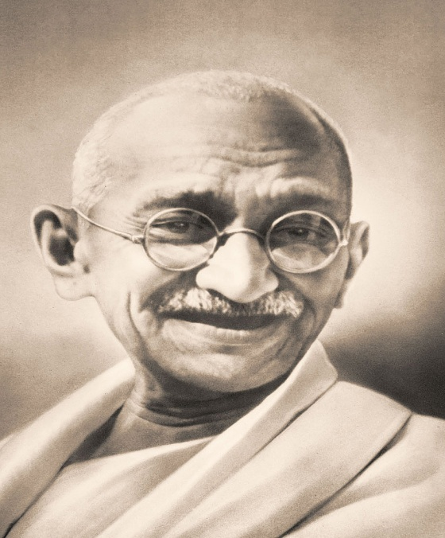
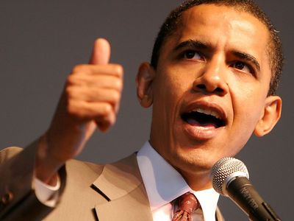
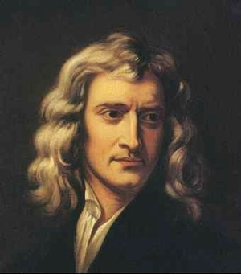

Slide 2
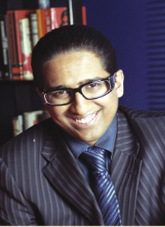
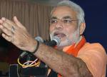
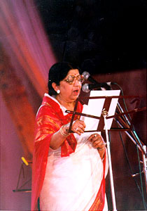
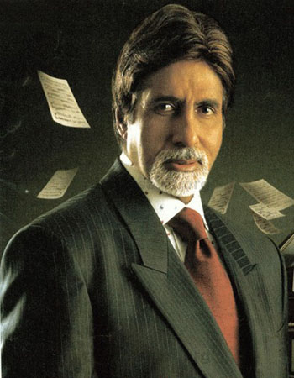

Slide 3
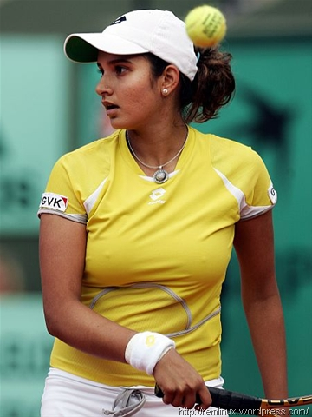
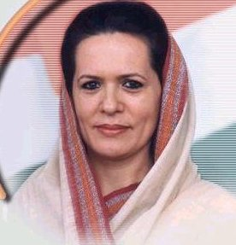
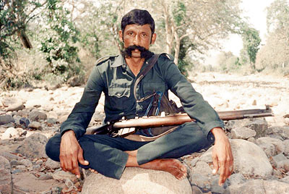

Slide 4
Chapter 5
Personality

Slide 5
Objective:
Introduction
Personality Determinants
Personality Theories
  William Sheldon
  Catell’s 16 PF
  MBTI
  Big Five Personality Model
  Type A Type B
Achieving Personality Fit

Slide 6
Introduction:
Latin term 'persona' which means to 'speak through'.
The Latin word denotes the masks worn by actors in ancient Greece and Rome.
Therefore, a very common meaning of the term personality is the role which the person (actor) displays in the public domain at large.

Slide 7
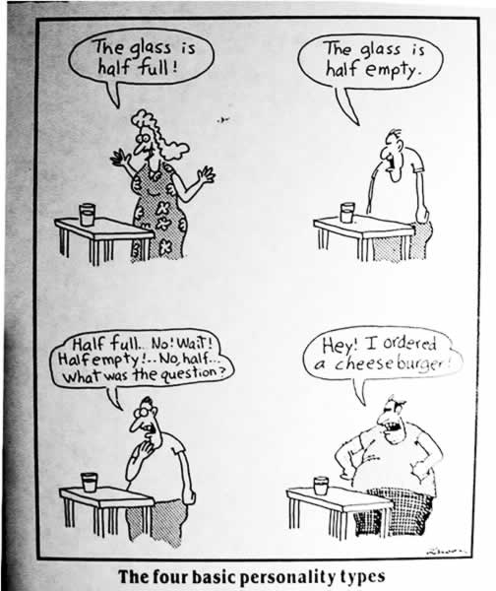

Slide 8
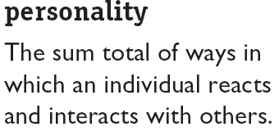
Personality
Gluck (1968)
“Personality is a pattern of stables and characteristics of a person that influences his or here behavior toward goal achievement. Each person has unique ways of protecting these states”
5-1
E X H I B I T

Slide 9
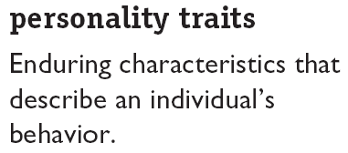
Personality Traits
Personality Determinants
Heredity
Environment
Culture
Family
Situation
Social Factors

Slide 10
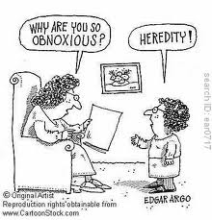
Heredity
Traits like physique, eye color, hair color, height, temperament, energy level, intelligence, reflexes, etc. are generally referred to describe the influence of heredity in developing personality.
Example:
Mukesh Ambani
Abhishek Bachchan

Slide 11
Environment
Comprises of Culture, Family, Social and Situational Factors.
The environmental factors influence personality of an individual since they provide the basis of certain experiences which determine the individual’s view about life, both positive and negative.
Examples :
Mogali,
Govinda – “jis desh me ganga rehta he”
Sita-gita

Slide 12
Culture
It establishes norms, attitudes and value that are passed on from generation to generation and create consistencies over time.
People from different culture groups have different attitudes towards independence, aggression, competition, cooperation, artistic talent, etc.

Slide 13
Family
One of the most important determinants of the personality of a person is the immediate family.
It influence in early stages of life.
The nature of such influence will depend upon the socio-economic level of the family, family size, race, religion, parent’s educational level and geographic location.

Slide 14
Situation and Social Factors
Situational factors also play a crucial role in determining the personality of a person.
Some of the events affect the personality of an individual
Examples
John Abraham - New York Movie
Amir khan - Lagan Movie

Slide 15
Personality Theories
William Sheldon, 1940’s
William Sheldon (1898-1977) was an American psychologist who devoted his life to observing the variety of human bodies and temperaments.
Sheldon proposed a theory about how there are certain body types (“somatotypes”) that are associated with certain personality characteristics.
He claimed that there are three such somatotypes:
Endomorphy, Mesomorphy and Ectomorphy
.

Slide 16
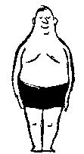
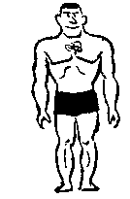

Table 5.1 Sheldon’s Classification of Personality Types.
Sheldon's Somatotype | Character | Shape | Picture
Endomorph [viscerotonic] | relaxed, sociable, tolerant, comfort-loving, peaceful | plump, buxom, developed visceral structure
Mesomorph [somatotonic] | active, assertive, vigorous, combative | muscular
Ectomorph [cerebrotonic] | quiet, fragile, restrained, non-assertive, sensitive | lean, delicate, poor muscles

Slide 17
Cattell’s 16 Personality Factor Model
Early research on personality traits resulted in isolating large numbers of traits, which made it impossible to predict behavior.
Cattell’s (1973) is one of the most important personality trait theory, where the number of traits have been reduced.
Cattell referred to these 16 factors as Primary Factors

Slide 18
Cont…
Primary Factors and Descriptors in Cattell.docx

Slide 19
The Myers-Briggs Type Indicator
The theory was pioneered by Swiss psychiatrist Carl Jung in the 1920s. He identified the ways people prefer to perceive their environment as obtain and process the information.
About 20 years later, in 1940s the mother-daughter team Katharine Briggs and Isabel Briggs Myers developed MBTI, a personality inventory designed to identify individuals’ basic preferences for perceiving and processing information.
MBTI is a personality test that taps four characteristics and classifies into 1 to 16 personality types

Slide 20
Extraversion
Introversion
E
Interest Orientation
I
Talkative,
Sociable,
Friendly,
Outspoken
Shy,
Reserved,
Quite,

Slide 21
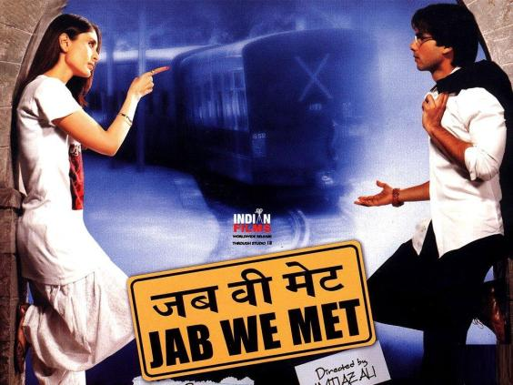
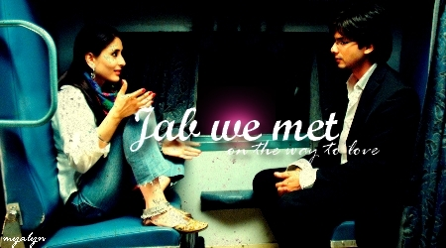

Slide 22
Sensing
iNtuition
S
Perception
N
Organised,
Practical,
Focus Detail.
Less Regular,
Unconscious,
Focus Big Picture

Slide 23

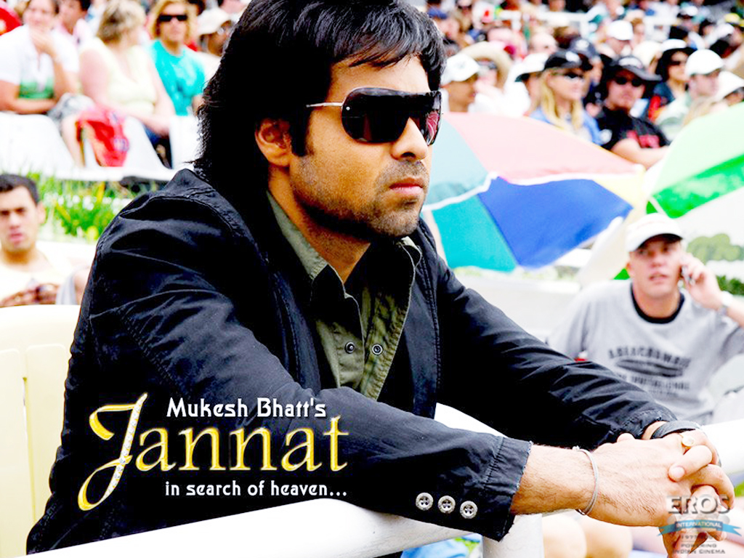

Slide 24
Thinking
Feeling
T
Judgment
F
Reliability of logical order – cause and effect,
Apathy
Priorities based on personal importance and values,
Sympathy

Slide 25
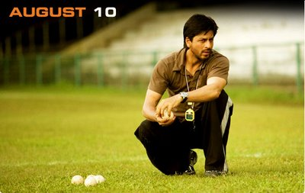


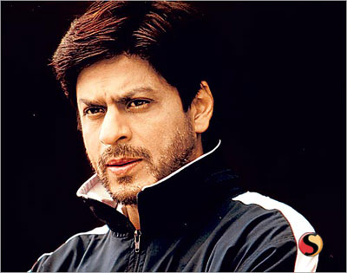
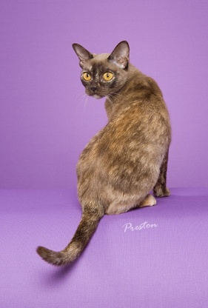

Slide 26
Judgment
Perception
J
Environment Orientation
P
Judging attitude – Control of events and systematic planning
Spontaneity – Curious, awaiting events and adapting to them,
Flexible

Slide 27
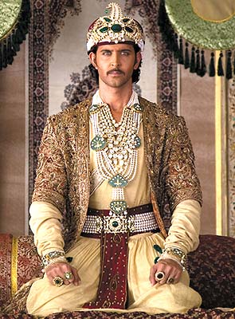
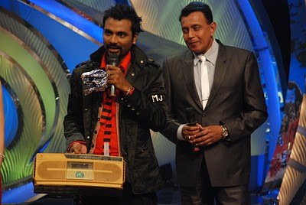

Slide 28
MBTI
    Extroverted (E) vs. Introverted (I)
    Sensing (S) vs. Intuitive (N)
    Thinking (T) vs. Feeling (F)
    Judging (J) vs. Perceiving (P)
INTJs are visionaries. They usually have original minds and great drive for their own ideas and purposes.
ESTJs are organizers. They are realistic, logical, analytical, decisive, and have a natural head for business or mechanics.
ENTP type is a conceptualize. He or she is innovative, individualistic, versatile, and attracted to entrepreneurial ideas.

Slide 29
ISTJ “Take Your Time and Do It Right” | ISFJ “On My Honor, to Do My Duty…” | INFJ “Catalyst for Positive Change” | INTJ “Competence + Independence = Perfection”
ISTP “Doing the Best I Can With What I’ve Got” | ISFP “It’s the Thought That Counts” | INFP “Still Waters Run Deep” | INTP “Ingenious Problem Solvers”
ESTP “Let’s Get Busy!” | ESFP “Don’t Worry, Be Happy” | ENFP “Anything’s Possible” | ENTP “Life’s Entrepreneurs”
ESTJ “Taking Care of Business” | ESFJ “What Can I Do For You?” | ENFJ “The Public Relations Specialist” | ENTJ “Everything’s Fine – I’m in Charge”

Slide 30
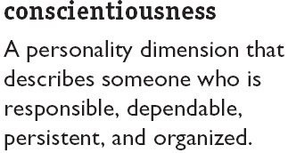
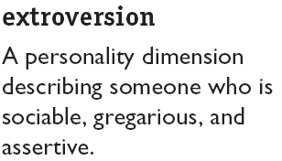
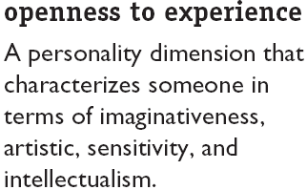
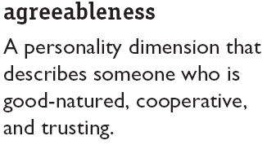
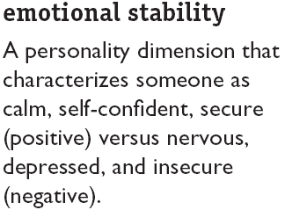
The Big Five Model

Slide 31
Major Personality Attributes Influencing OB
Locus of control
Machiavellianism
Self-esteem
Self-monitoring
Propensity for risk taking
Type A personality

Slide 32
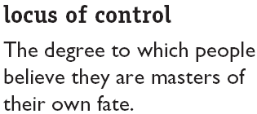
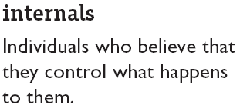
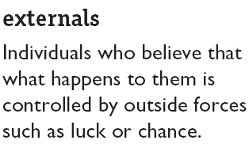
Locus of Control

Slide 33
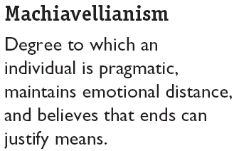
Machiavellianism
Conditions Favoring High Machs
Direct interaction
Minimal rules and regulations
Distracting emotions

Slide 34
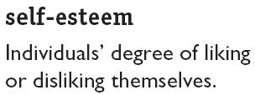
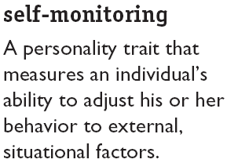
Self-Esteem and Self-Monitoring

Slide 35
Personality Types
Type A personality
Aggressive involvement in a chronic, incessant struggle to achieve more and more in less and less time and if necessary against the opposing efforts of other things or other people.

Slide 36
Type B Personality
Never suffer from a sense of time urgency with its accompanying impatience and feel no need to display or discuss either their achievements or accomplishments unless such exposure is demanded by the situation.

Slide 37
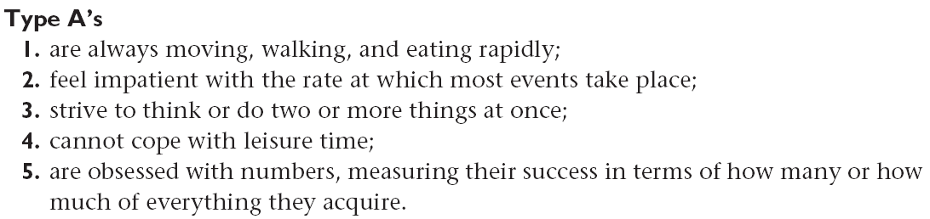
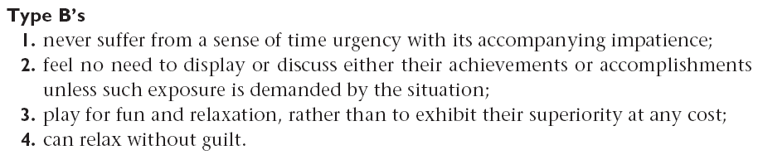
Personality Types

Slide 38
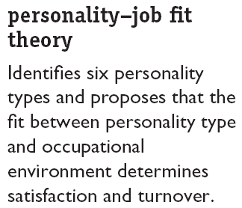
Achieving Personality-Job Fit
Personality Types
Realistic
Investigative
Social
Conventional
Enterprising
Artistic

Slide 39
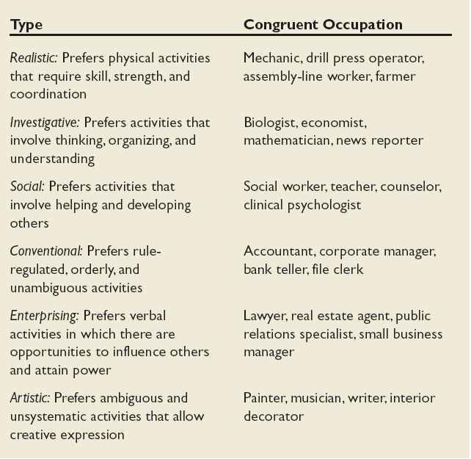
Holland’s Typology of Personality and
Congruent Occupations
5-3
E X H I B I T

Slide 40

Holland’s Personality-Job Fit Theory
Type
Personality
Occupations
Realistic
Shy, Stable, Practical
Mechanic, Farmer,
Assembly-Line Worker
Investigative
Analytical, Independent
Biologist, Economist,
Mathematician
Social
Sociable, Cooperative
Social Worker,
Teacher, Counselor
Conventional
Practical, Efficient
Accountant, Manager
Bank Teller
Enterprising
Ambitious, Energetic
Lawyer, Salesperson
Artistic
Imaginative, Idealistic
Painter, Writer,
Musician

Slide 41
Thank you

